Slide 1
Fundamentals of Computing 1
Lecture 10: Abstract class and Interface

Slide 2
Learning Objectives
To apply class abstraction to develop software
To design and use abstract classes
To specify common behavior for objects using interfaces
To define interfaces and define classes that implement interfaces
Notes:
ask them, how might the computer store "hi" using binary digits? (some kind of mapping; ASCII)

Slide 3
Agenda
Abstract
Interface
Exercises
Notes:
ask them, how might the computer store "hi" using binary digits? (some kind of mapping; ASCII)

Slide 4
Abstract class in Java
Before abstract class, let's understand the abstraction first.

Slide 5
Abstraction
Abstraction is a process of hiding the implementation details and showing only functionality to the user. Another way, it shows only important things to the user and hides the internal details
Abstraction lets you focus on what the object does instead of how it does it.

Slide 6
Ways to achieve Abstaction
There are two ways to achieve abstraction in java
  Abstract class (0 to 100%)
  Interface (100%)

Slide 7
Abstract class
A class that is declared as abstract is known as abstract class.
Syntax to declare the abstract class
abstract class <class_name>{}
It needs to be extended and its method implemented.
It cannot be instantiated

Slide 8
Abstract method
A method that is declared as abstract and does not have implementation is known as abstract method.
Syntax to define the abstract method
abstract return_type <method_name>();
//no braces{}

Slide 9

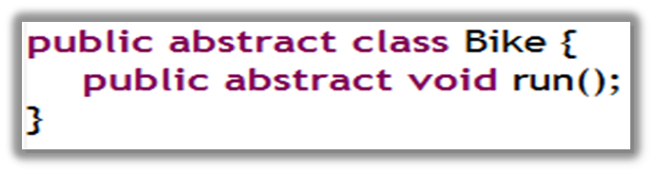
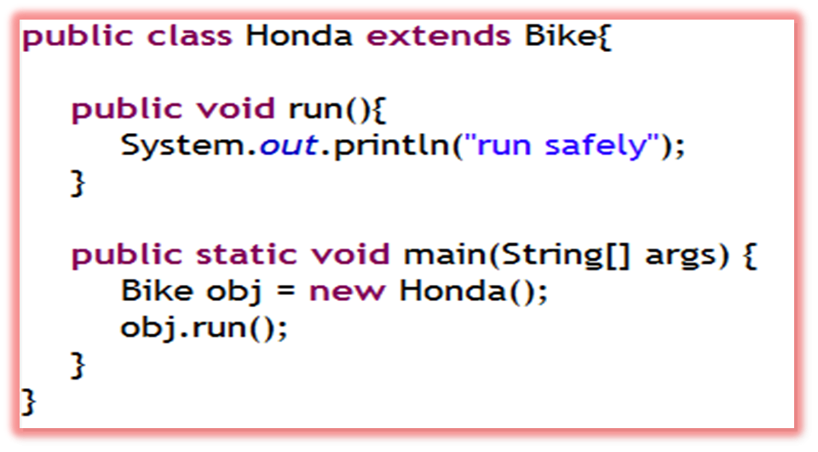

Example of abstract class that have abstract method
Notes:
In this example, Bike the abstract class that contains only one abstract method run. It implementation is provided by the Honda class.

Slide 10
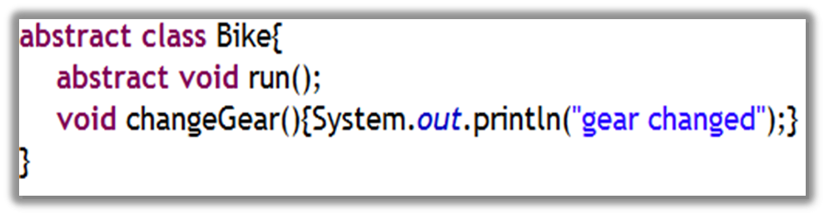
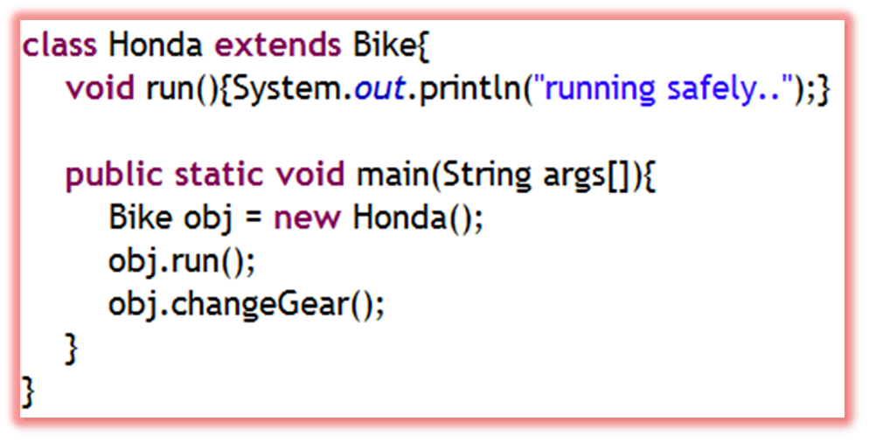

Abstract class having method body

Slide 11
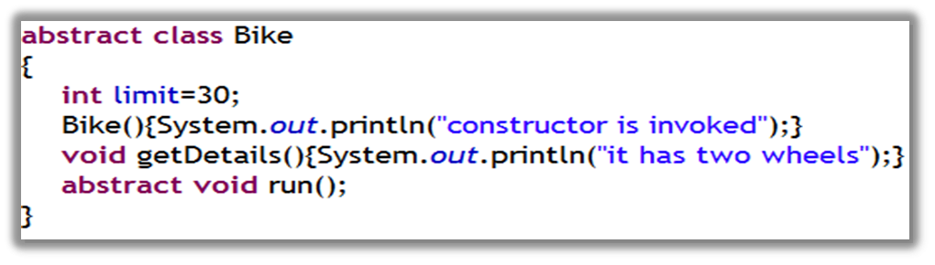
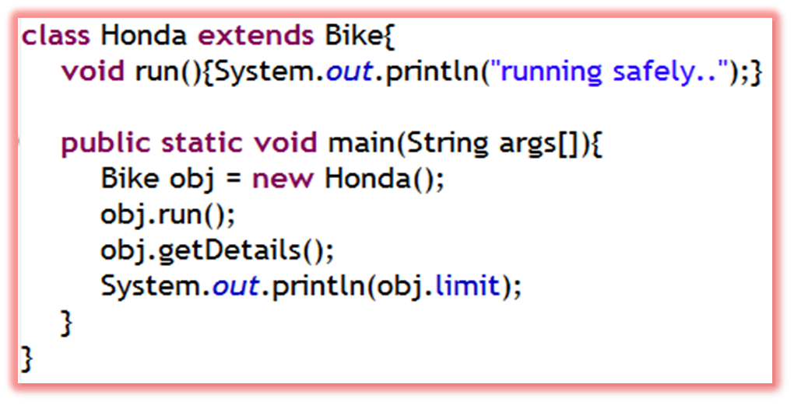
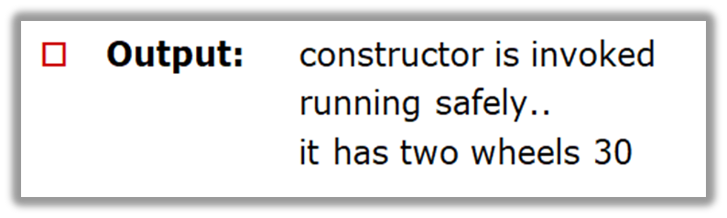
Abstract class having constructor, field and method body

Slide 12

Question
True or false?
  a. An abstract class can be used just like a nonabstract class except that you cannot use the new operator to create an instance from the abstract class.
  b. An abstract class can be extended.
  c. A subclass of a nonabstract superclass cannot be abstract.
  d. An abstract method must be nonstatic.

Slide 13

Answer
a. True
b. True
c. False
d. True

Slide 14
Agenda
Abstract
Interface
Exercises

Slide 15
Interface
An interface is a blueprint of a class. It has static constants and abstract methods
The interface is a mechanism to achieve abstraction in java.
There can be only abstract methods in the interface. It is used to achieve fully abstraction and multiple inheritance in Java

Slide 16
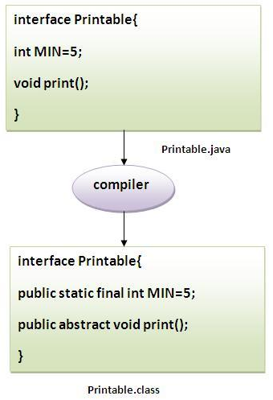
Interface (cont’d.)
The java compiler converts methods of interface as public and abstract, data members as public, final and static by default.

Slide 17
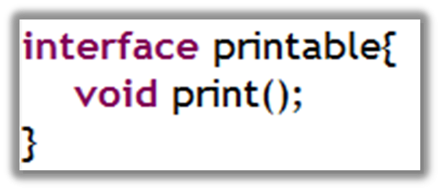
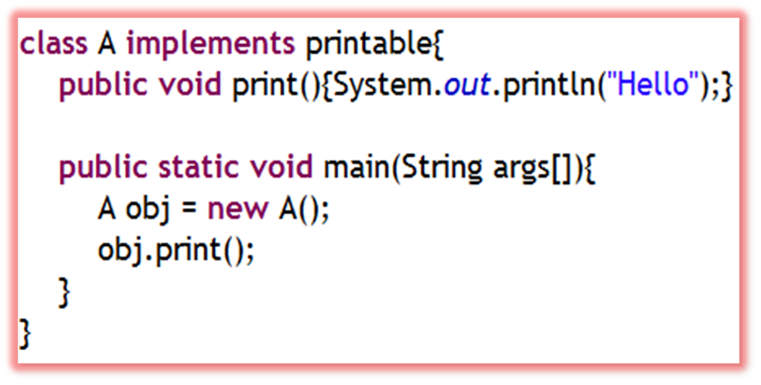

Simple example of Interface
Notes:
In this exmple, Printable interface have only one method, its implemenation is provided in the A class

Slide 18
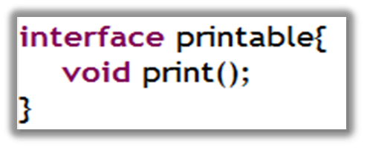
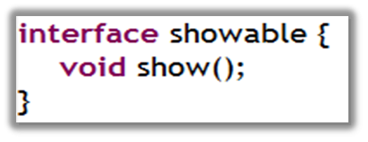
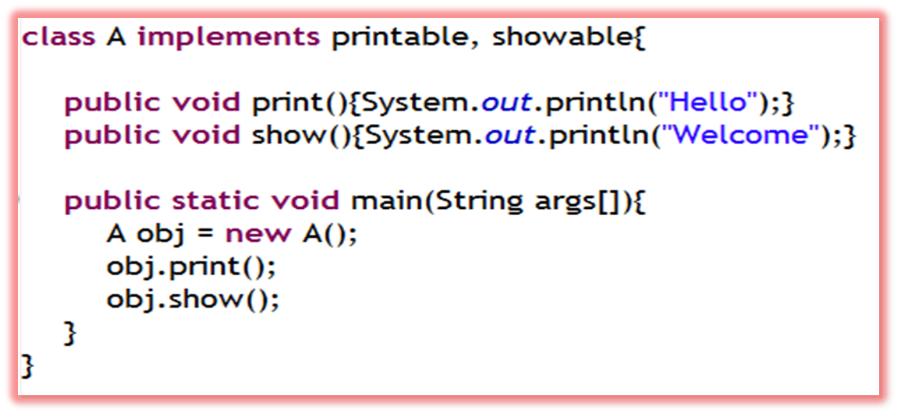

Multiple inheritance by interface

Slide 19
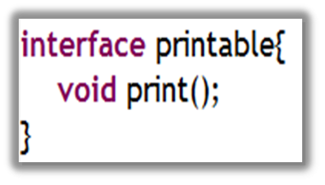
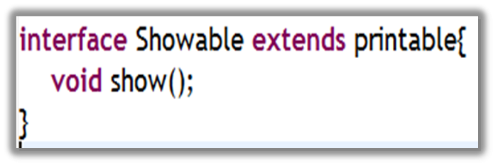
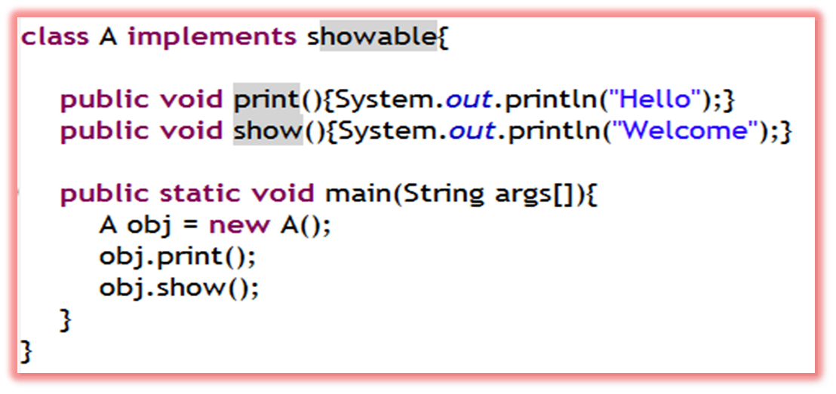

Rule: A class implements interface but One interface extends another interface

Slide 20
Question
1. Can abstract class be instantiated?
2. Does an abstract method have implementation?
3. Why use Interface?
4. What does the java compiler convert methods of interface as?
5. What does the java compiler convert data members as by default?

Slide 21
Answer
1. No, it can not
2. No, it does not have implementation
3. By interface, we can support the functionality of multiple inheritance
4. public
5. public, final and static

Slide 22
Agenda
Abstract
Interface
Exercises
Notes:
ask them, how might the computer store "hi" using binary digits? (some kind of mapping; ASCII)

Slide 23
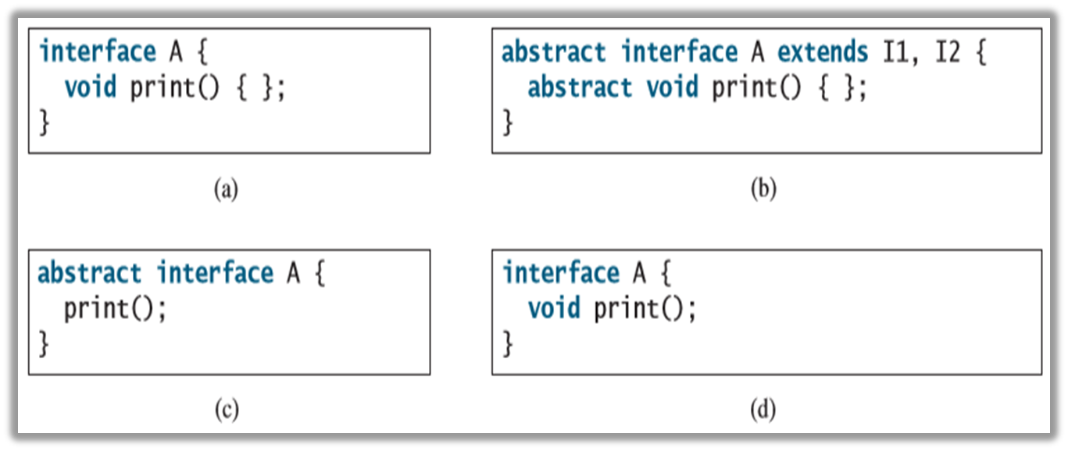
Exercise 1
Which of the following is a correct interface?

Slide 24
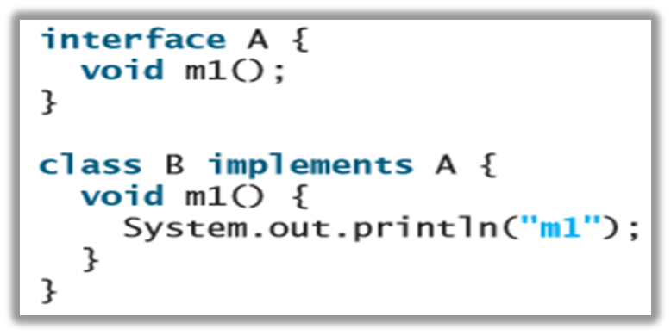
Exercise 2
Show the error in the following code:

Slide 25
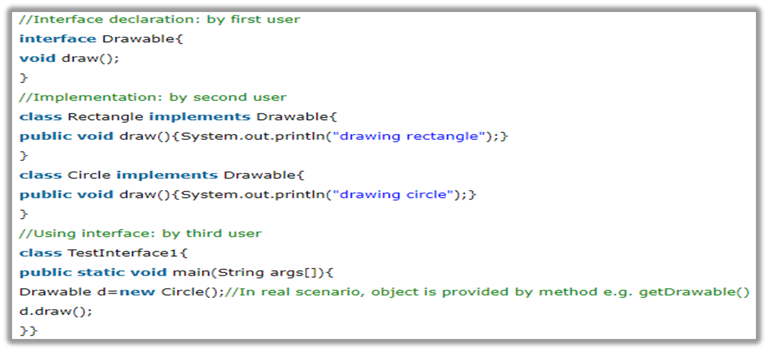
Exercise 3
What is output of the following program?
Notes:
drawing circle

Slide 26
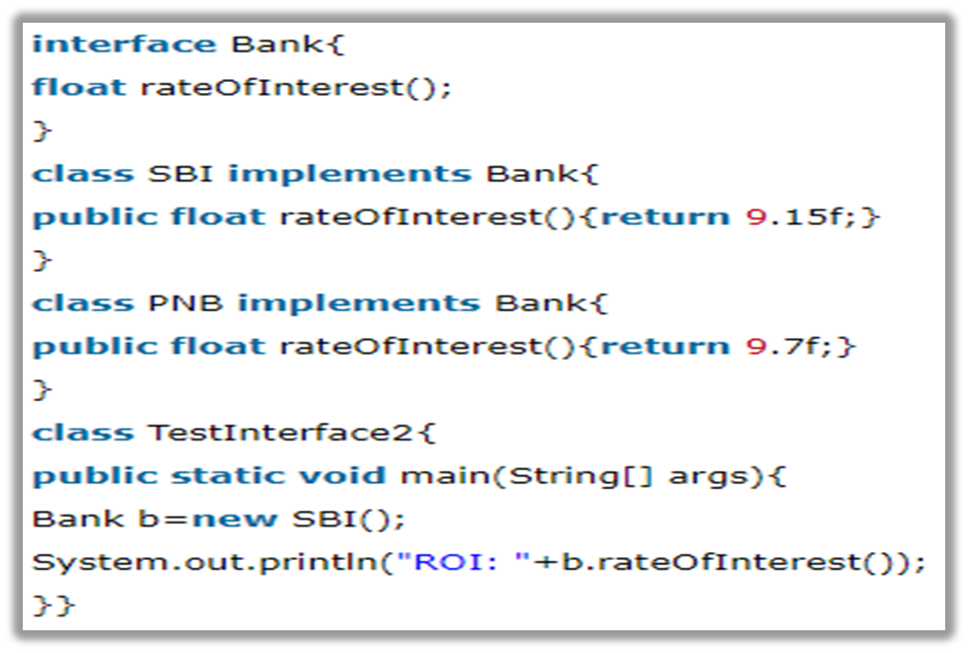
Exercise 4
What is output of the following program?
Notes:
ROI: 9.15

Slide 27
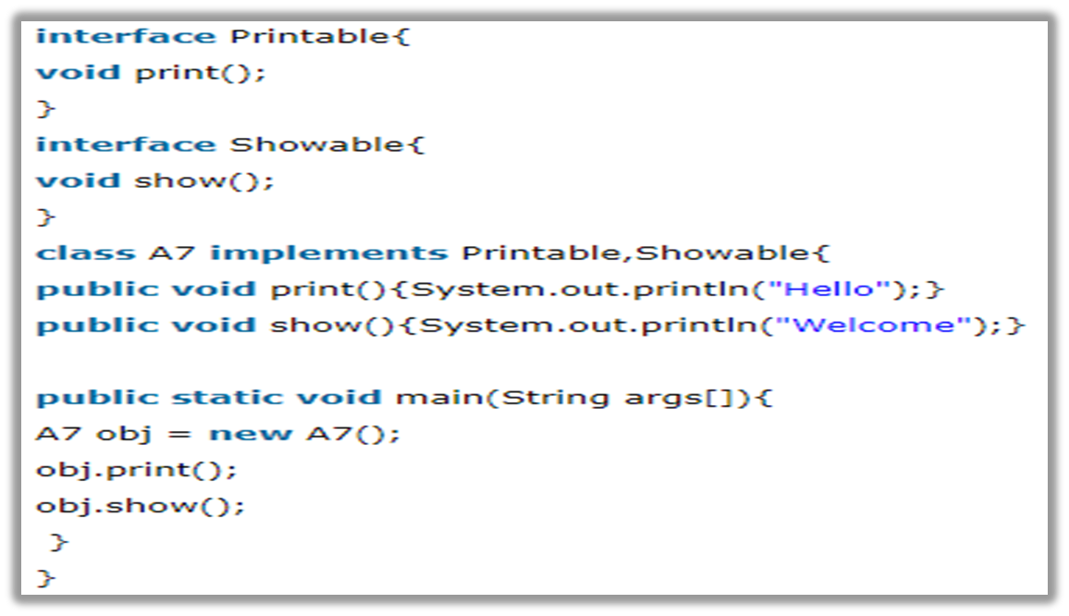
Exercise 5
What is output of the following program?
Notes:
Output:
Hello
Welcome

Slide 28
Agenda
Abstract
Interface
Exercises
Notes:
ask them, how might the computer store "hi" using binary digits? (some kind of mapping; ASCII)

Slide 29
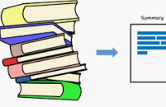
Summary (part 1 of 3)
Abstract classes are like regular classes with data and methods, but you cannot create instances of abstract classes using the new operator.
An abstract method cannot be contained in a nonabstract class. If a subclass of an abstract superclass does not implement all the inherited abstract methods of the superclass, the subclass must be defined as abstract.

Slide 30
Summary (part 2 of 3)
A class that contains abstract methods must be abstract. However, it is possible to define an abstract class that doesn’t contain any abstract methods.
A subclass can be abstract even if its superclass is concrete.

Slide 31
Summary (part 3 of 3)
An interface is a class-like construct that contains only constants and abstract methods. In many ways, an interface is similar to an abstract class, but an abstract class can contain constants and abstract methods as well as variables and concrete methods.
An interface is treated like a special class in Java. Each interface is compiled into a separate bytecode file, just like a regular class.

Slide 32
References (part 1 of 2)
Read Chapter 13 from page 495 page 535 of the material:
Liang, Daniel Y. (2014). Introduction to Java Programming Comprehensive, 10th Edition. U.S: Pearson-Prentice Hall.

Slide 33
References (part 2 of 2)
Abstract Methods and Classes
  https://www.youtube.com/watch?v=vcN_mXHPXVA&list=PLS1QulWo1RIbfTjQvTdj8Y6yyq4R7g-Al&index=28
Java Interfaces
  https://www.youtube.com/watch?v=HxmP7ZVUeGU&list=PLS1QulWo1RIbfTjQvTdj8Y6yyq4R7g-Al&index=29

